Slide 1
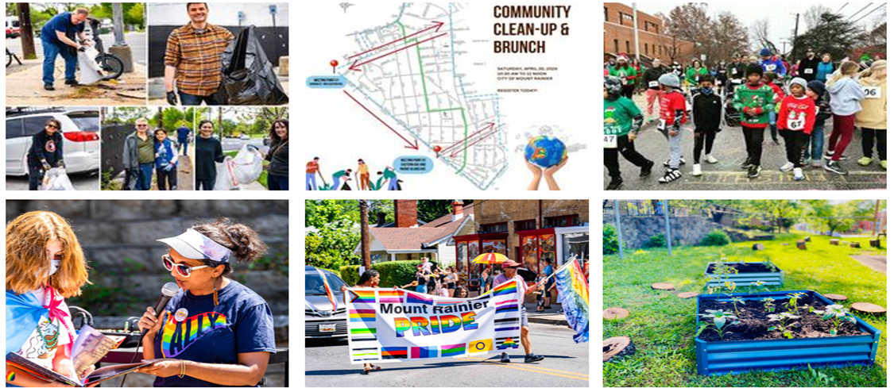
Mount Rainier Recreation Committee
2024-2025 Update to Mount Rainier City Council
February 2025

Slide 2
About Us
The Mount Rainier Recreation Committee aims to facilitate multi-generational recreational opportunities in the areas of sports, appreciation of our natural environment, and the arts. The committee is the steward for the City of Mount Rainier recreational resources ensuring that residents have full access and take full advantage of our neighborhood treasures.
500+
Residents engaged
4
Impactful events each year
2
Grants awarded
5
Committee members
2
New committee members in 2024
FY25
Notes:
What makes MtR a great place to live. We can all speak…
Draft talking points
Intro
About Us
Events
Pink to send
Impact
Anecdotes
Start a PPT (Steph)
Emily: Grants
Steph: Events
Bethany: Quotes
Slide for upcoming calendar for 2025
Introduce who we are, what we do and updates from grant applicants, and impact data. No more than 7 or 8 minutes.

Slide 3
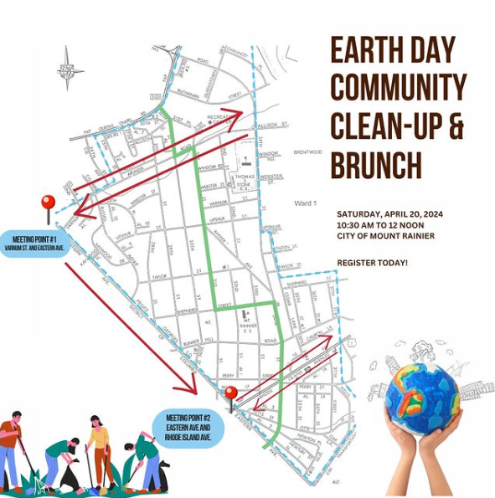
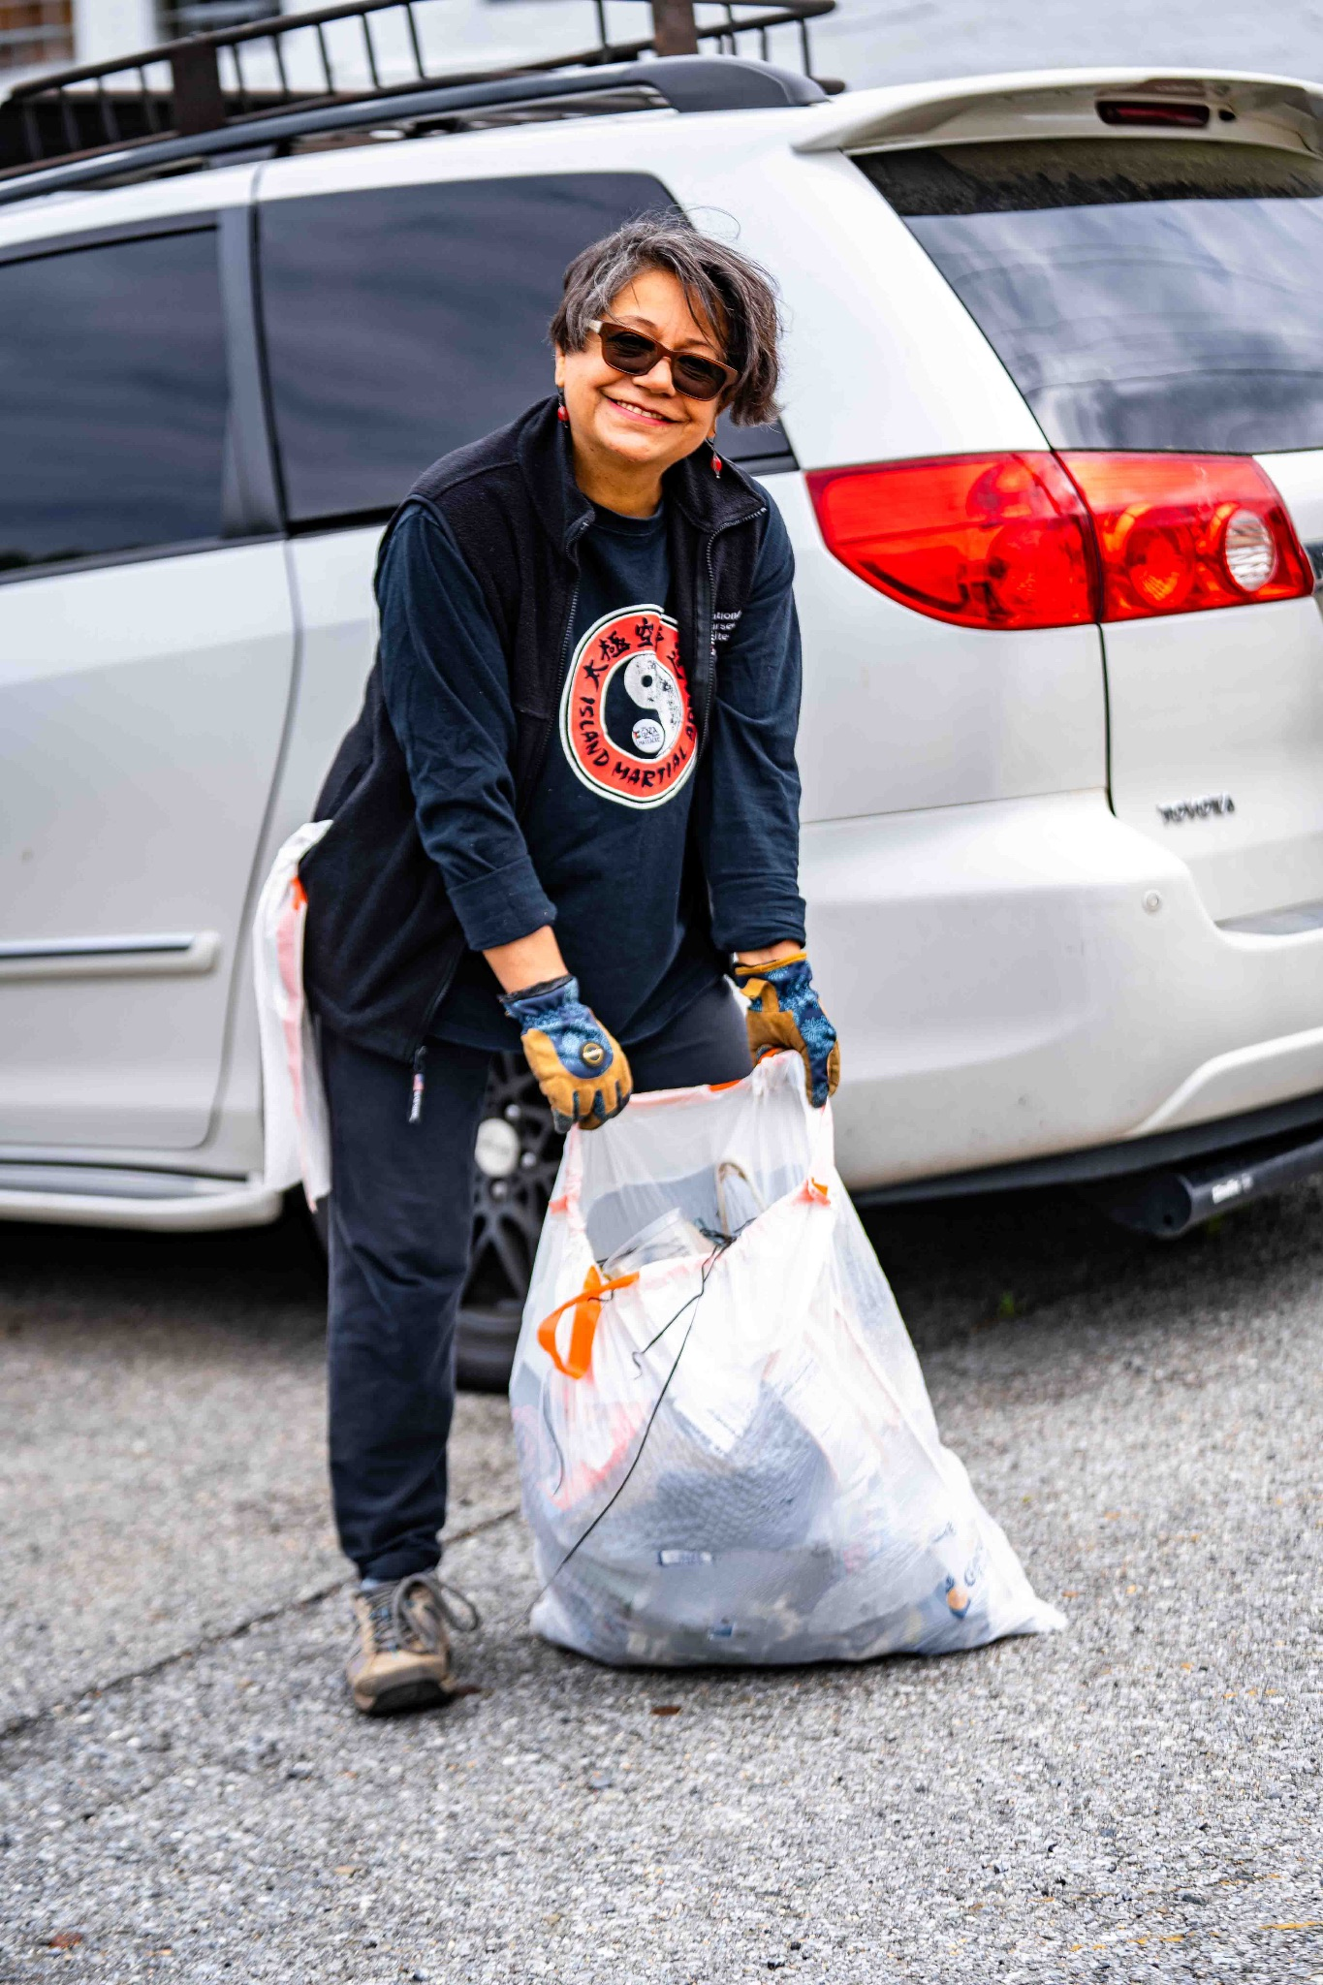
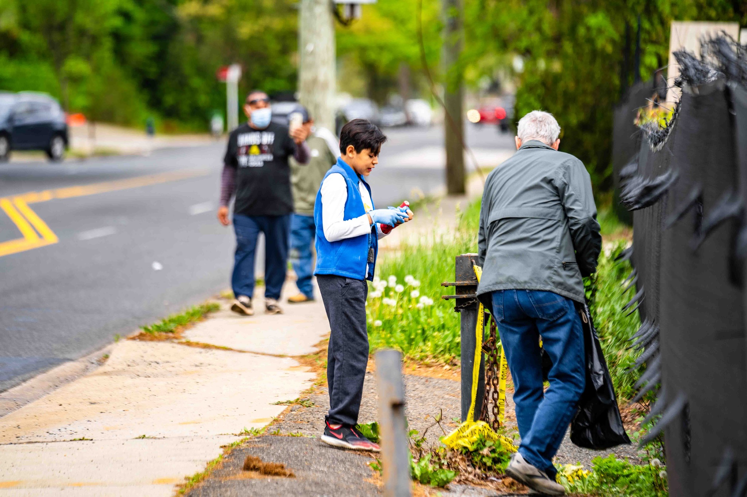
Community Clean Up & Brunch
“The clean up was definitely needed -- there was a lot of plastic bottles, cups, liquor bottles, and even some clothes. The event had a real impact -- I believe it increased the overall curb appeal of the neighborhood and it definitely helped get people outside and moving.” - Torrence Cook, resident
Notes:
Speaker Notes: Neighbors turned up to pick up trash along busy streets and then gathered at J&J Taqueria for a delicious brunch.

Slide 4
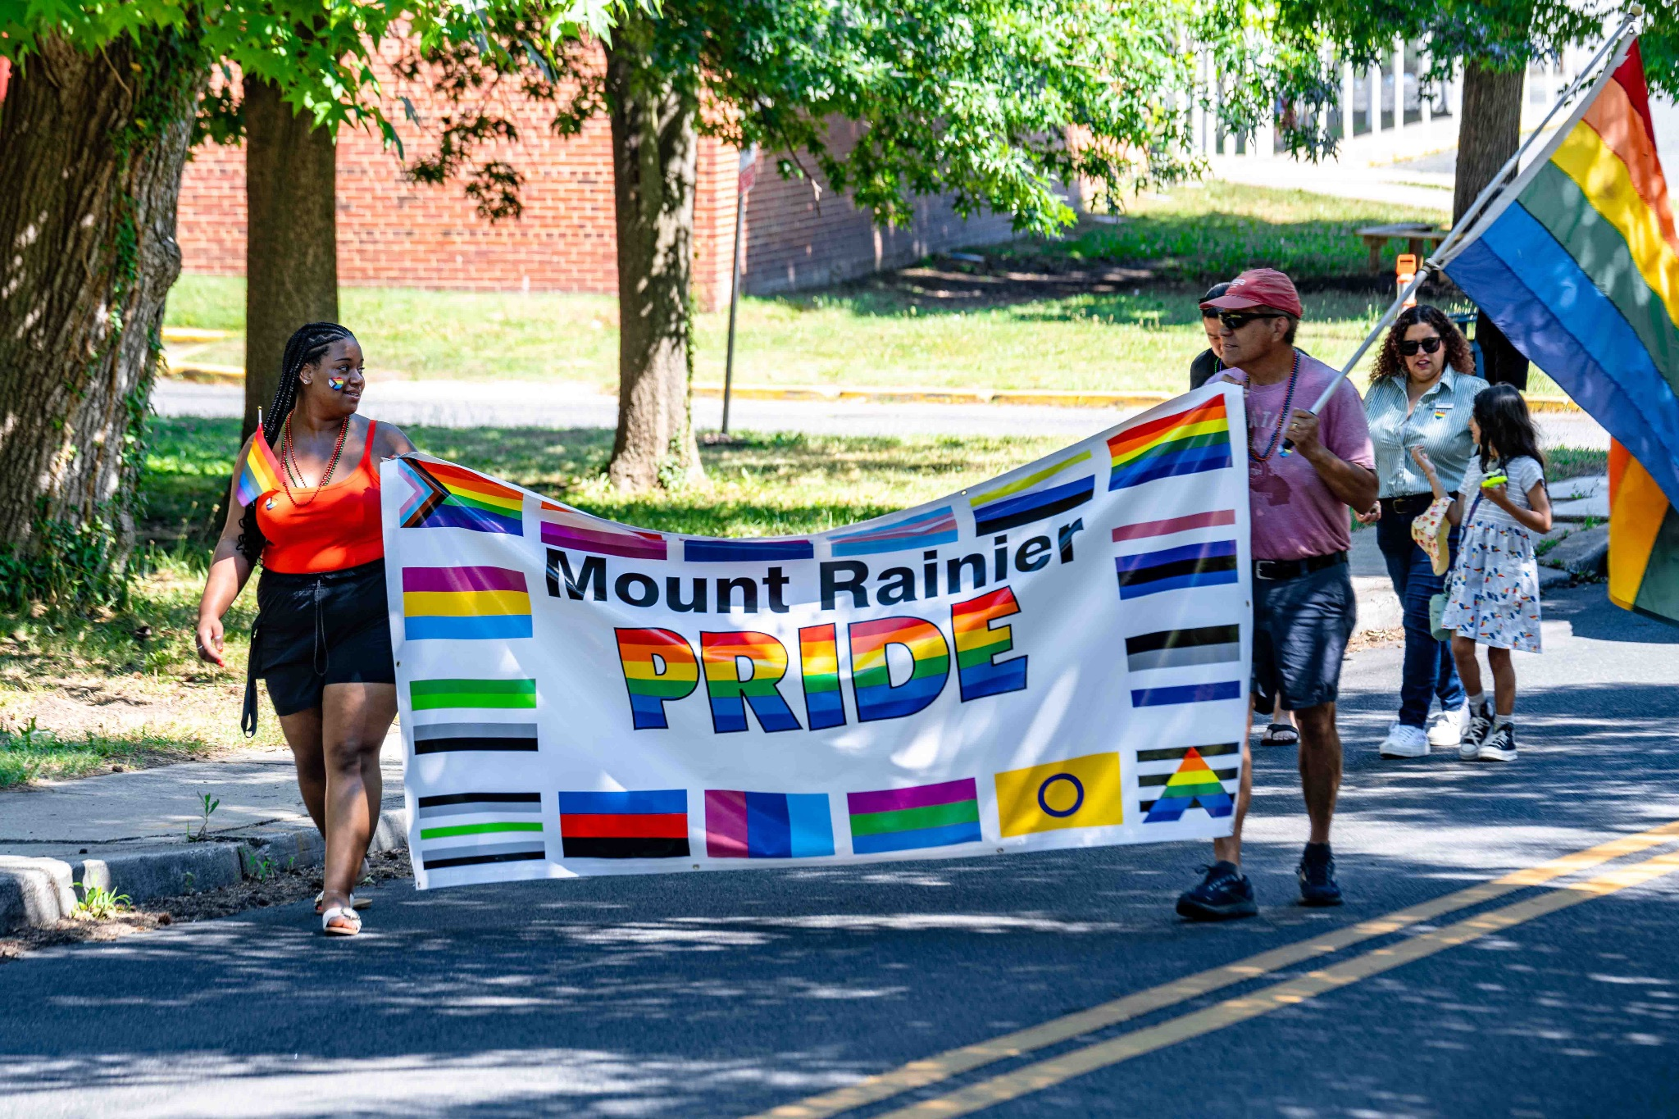
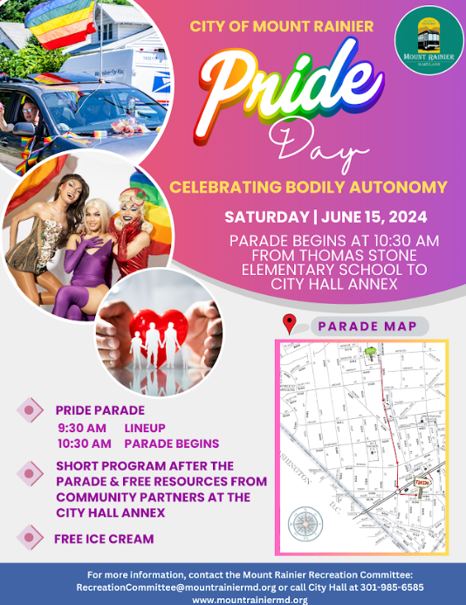
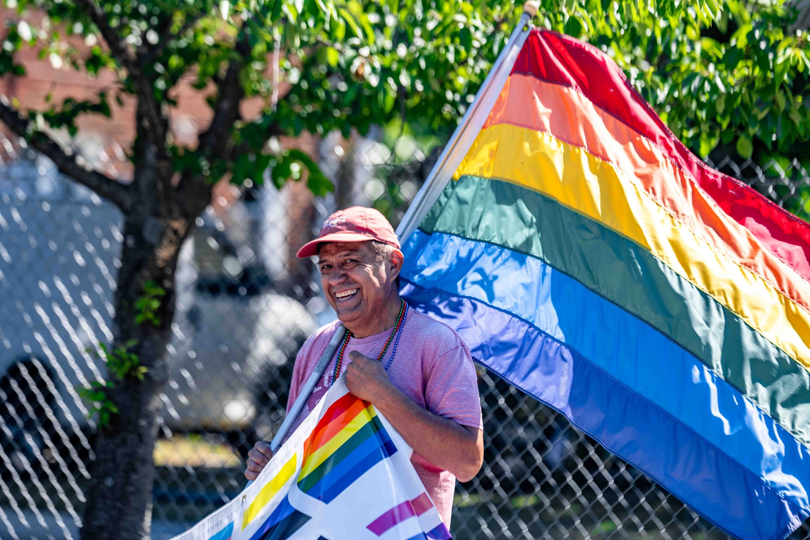
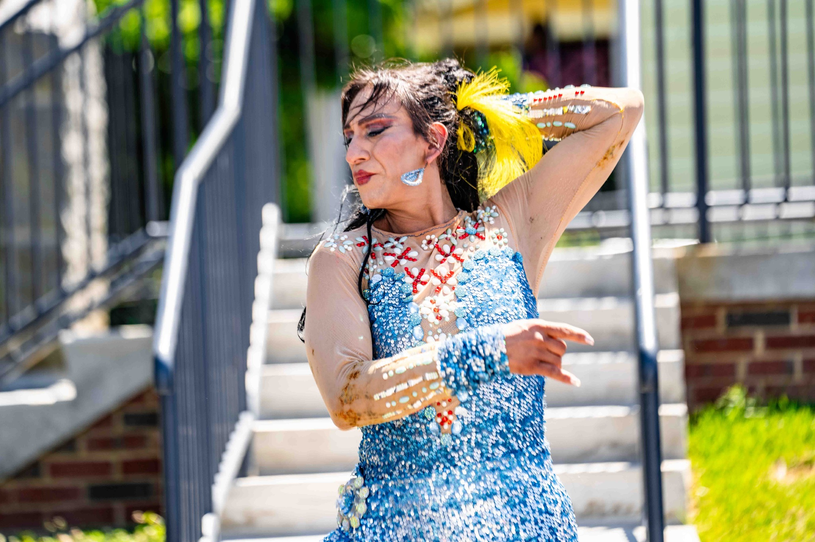
MtR Pride Day
“Our town’s Pride parade and event was a heartfelt celebration of love, acceptance, and the vibrant spirit of our community. It was a truly beautiful day where kids, families, and neighbors united to embrace authenticity, uplift one another, and share in the joy of being exactly who they are."
Nicole de la Torre, resident
Notes:
Speaker Notes: Pride 2024 featured a joyful parade through the heart of town followed by a community resource and solidarity fair featuring more than a dozen local LGBTQ+ supportive organizations.

Slide 5
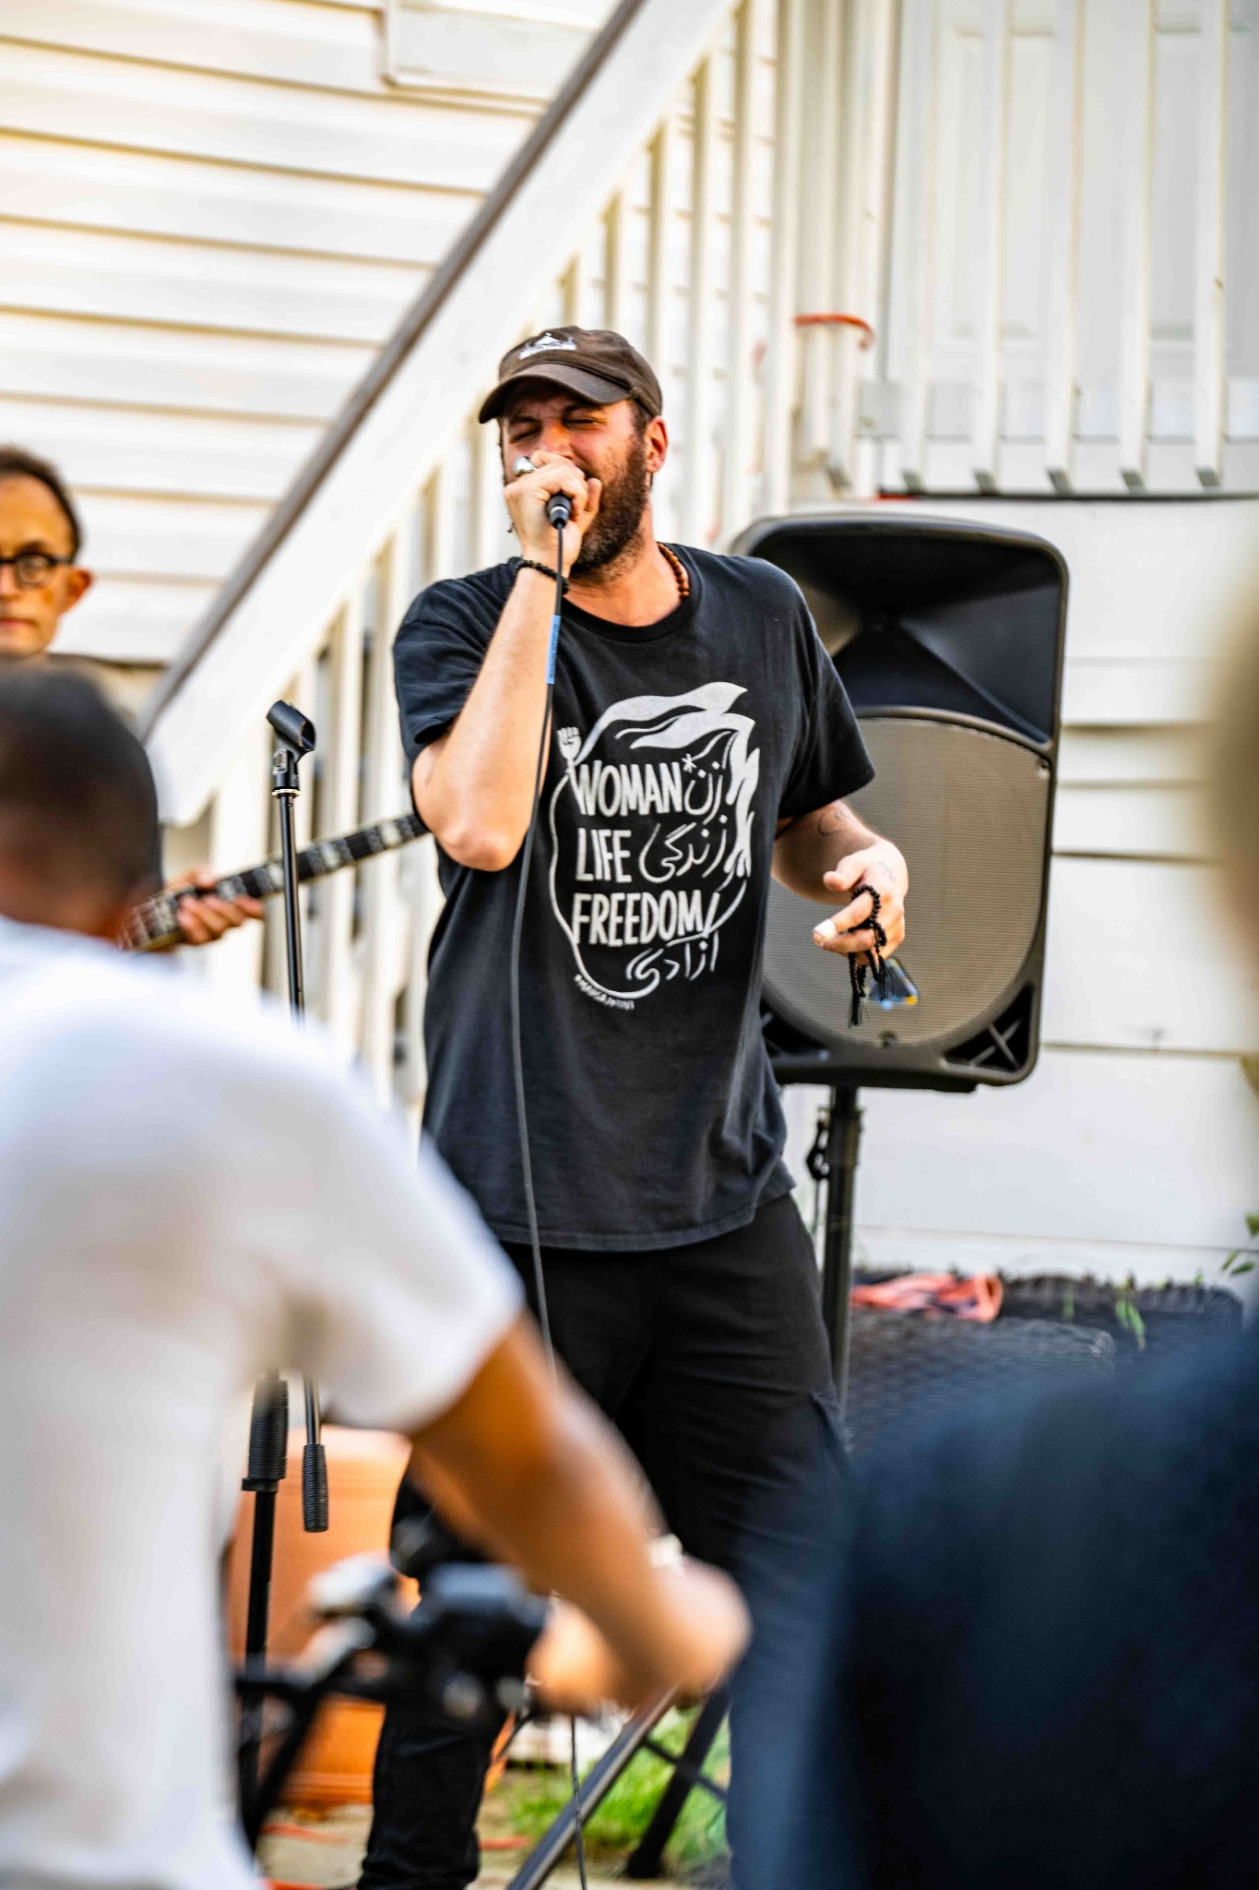
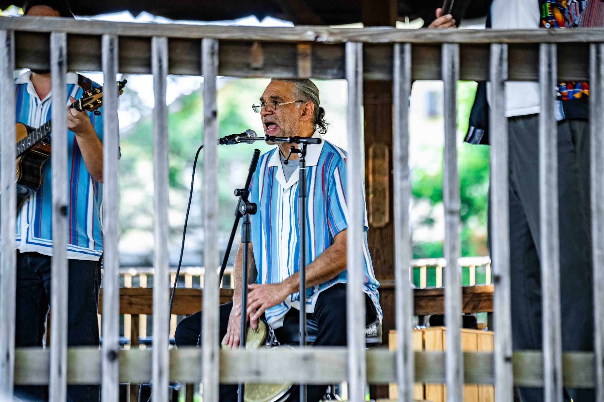
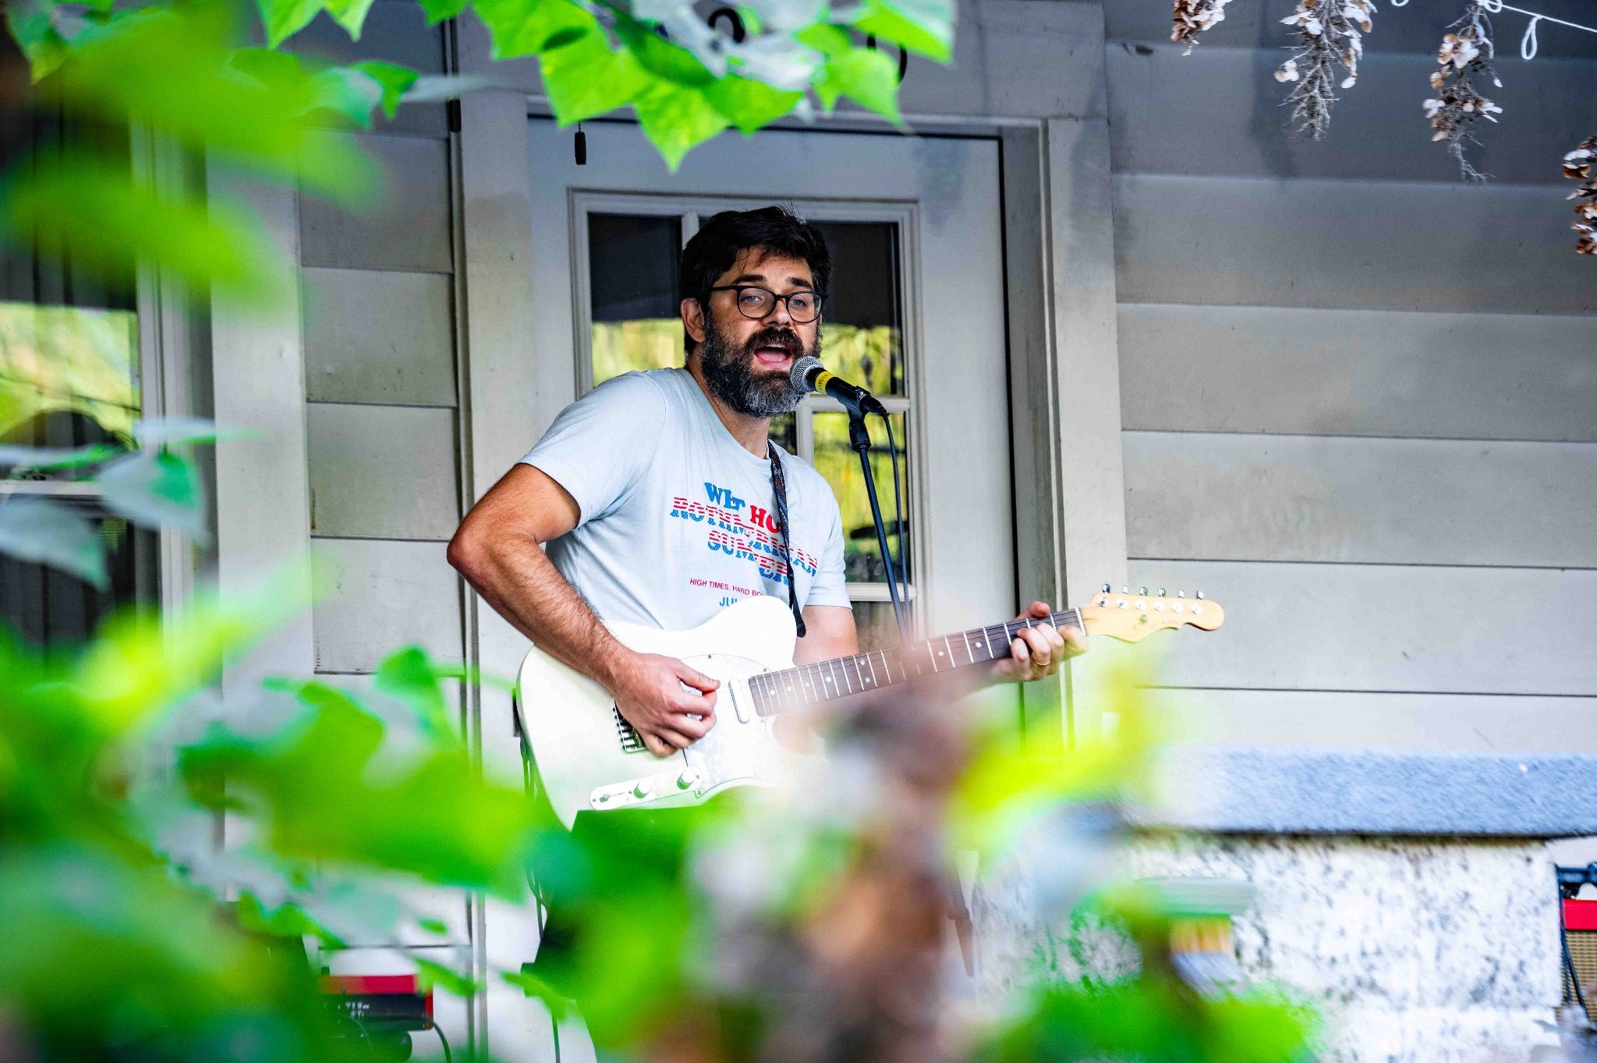
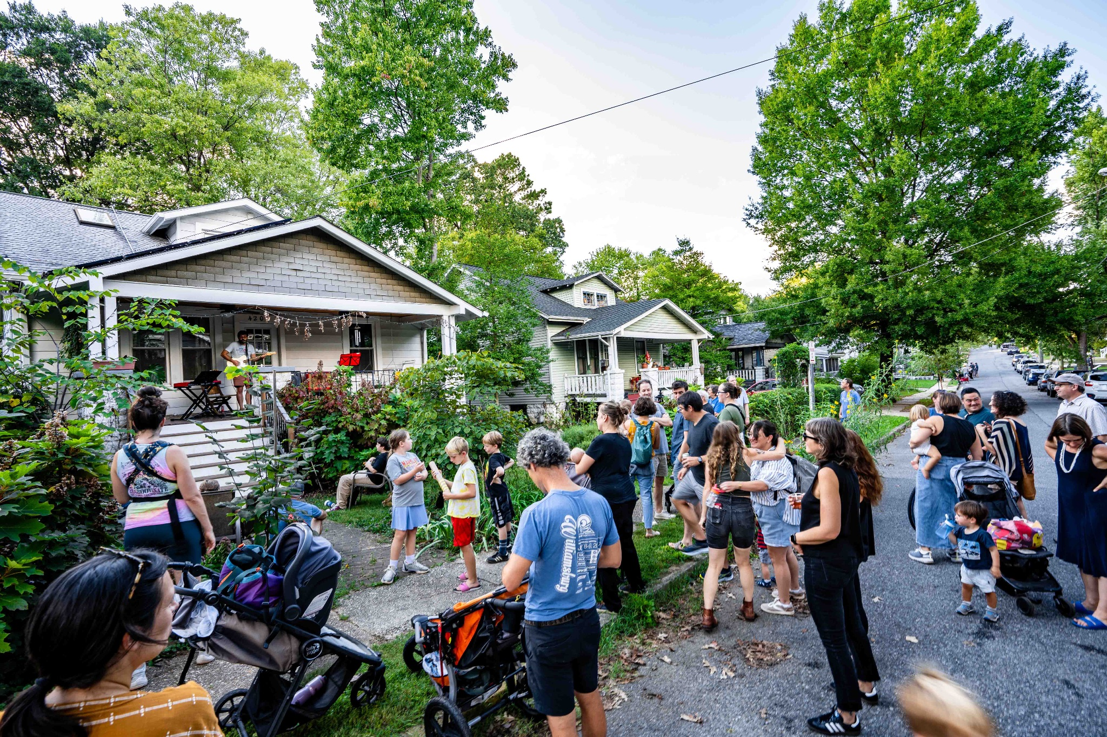
Porchfest
“A casual way to celebrate our local artists and community. It was inclusive to all ages, low-key and accessible.” - Chris Winnike, resident
“Porchfest inspired a sense of community. It makes the city a wonderful place to live as we have gotten to know neighbors and the people who have kids close in age to us. Our kids loved dancing at porchfest!” - Natalie Andrews, MR resident
Notes:
Speaker Notes: Held on a beautiful Saturday afternoon in September, Porchfest drew over 20 kids for a front porch art project, and 100+ neighbors came out for shows on 31st Street, neighboring porches, and a Cuban music dance party at the Gazebo.

Slide 6
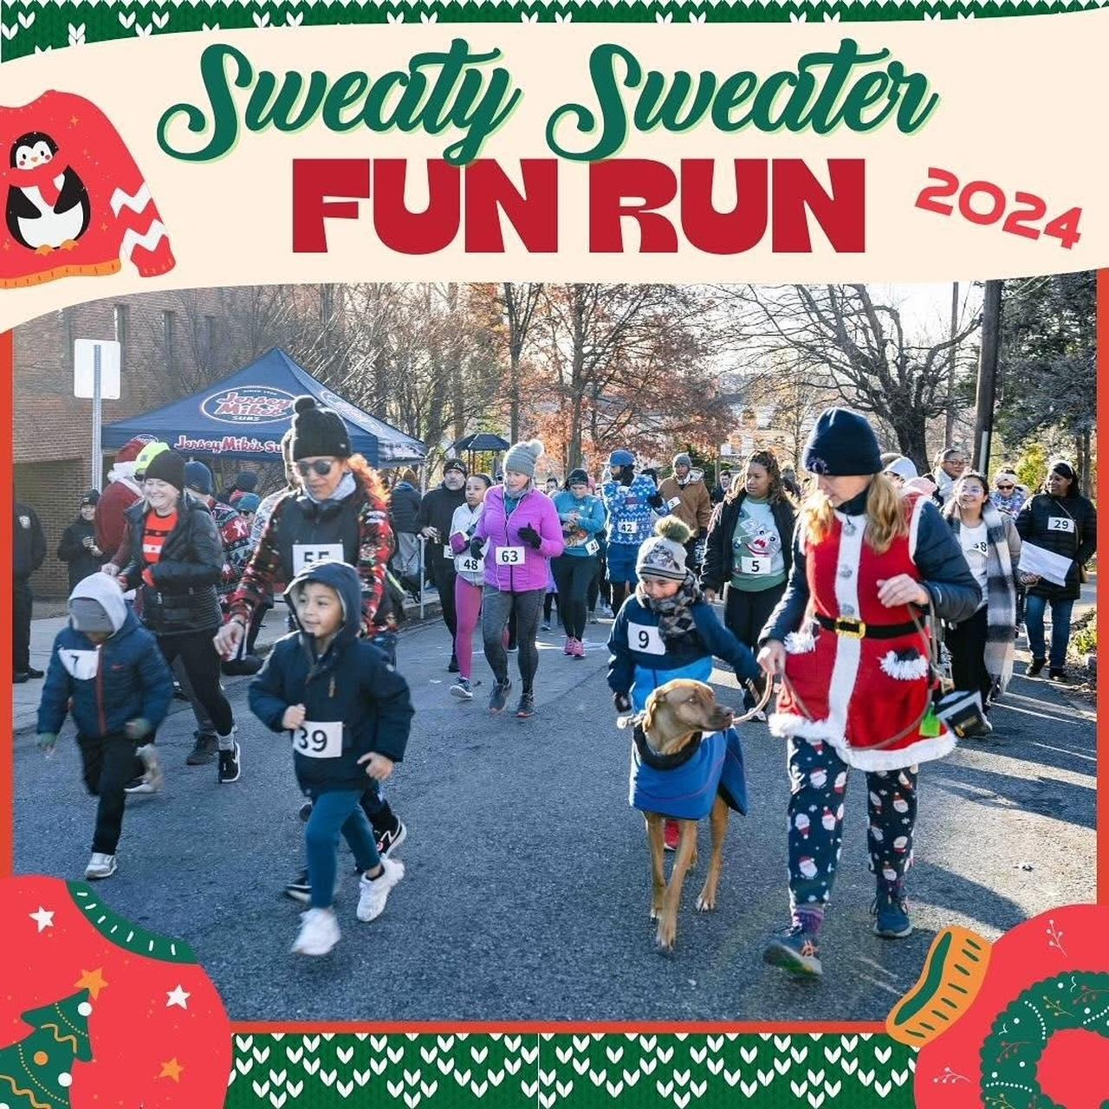
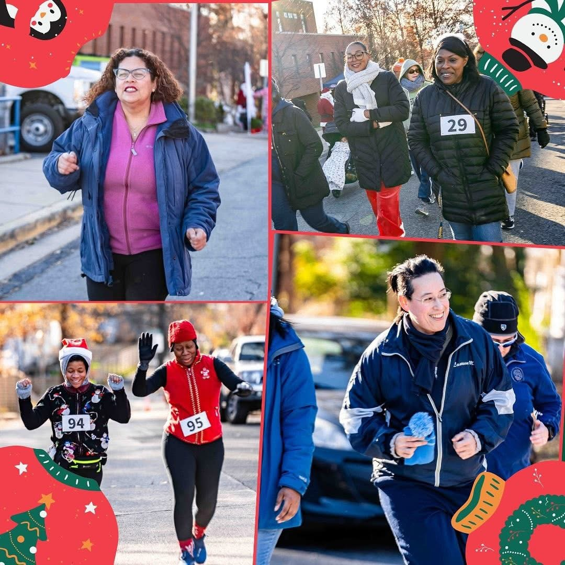
“The sweaty sweater run is a fantastic community tradition. It gets folks out running or taking a walk and eating snacks as a community, renewing bonds with old neighbors as well as making new bonds with new-to-us neighbors” - a Mount Rainier resident
Notes:
Speaker Notes: 2nd annual Sweaty Sweater was a success! Word is out about how fun the event is and we had a 33% increase in registrations over last year! 206 registrations this year and we gave out more than 100+ medals

Slide 7
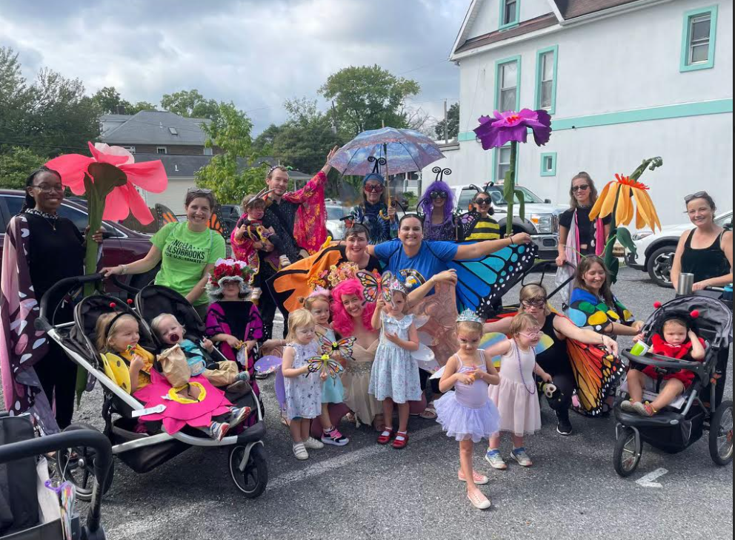
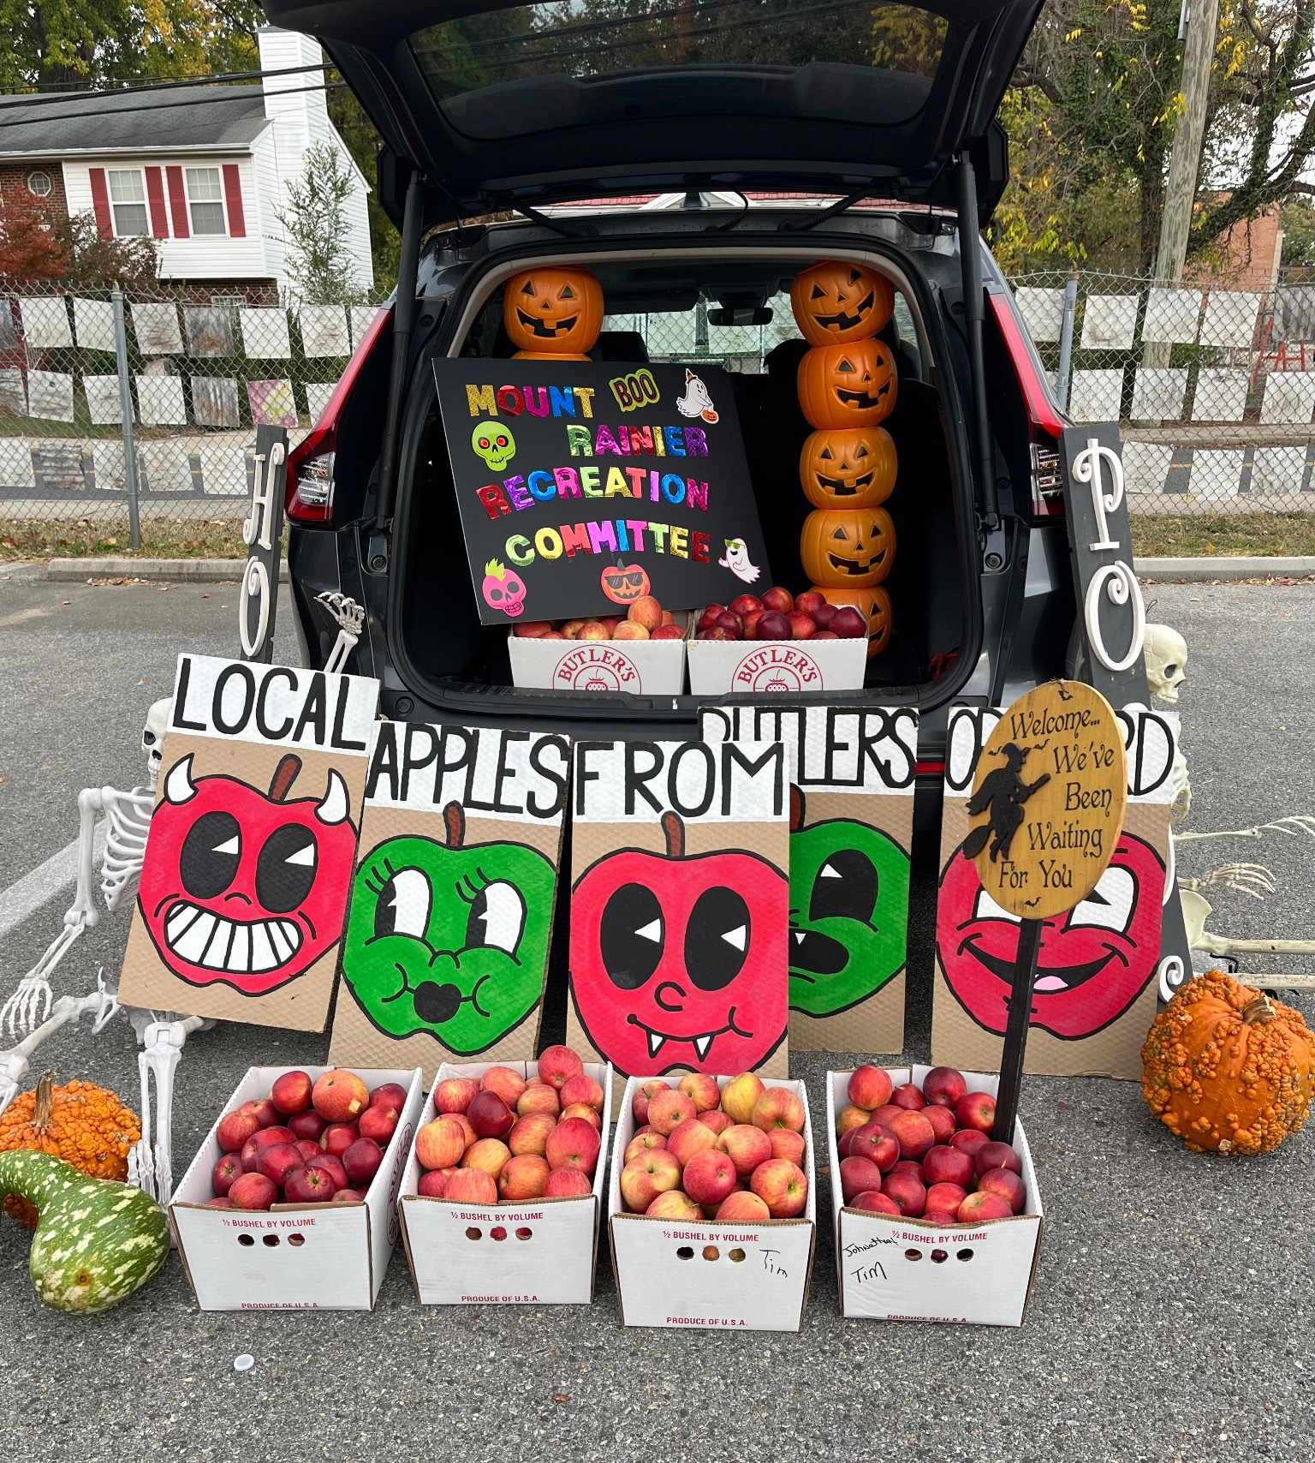
Participation in other community-led events
Mount Rainier Day Parade
Mount Rainier PD Trunk or Treat

Slide 8
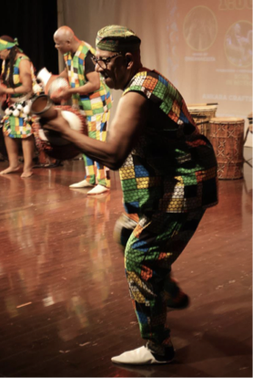
Recreation Grant Application
The City of Mount Rainier believes that supporting community activities enhances the community as a whole. In support of that belief, the City Council established a Recreation Activities Grant.
Up to $2,500 to organizations or individuals that wish to hold programs, activities, and events.
Grant provides reimbursement of eligible expenses.
Programs must be open to residents of MtR and promote enhanced community engagement.
Applications accepted on a rolling basis until May 20, 2025 for the current fiscal year.
Visit the Rec Committee’s site for more information and to access application: https://www.mountrainiermd.org/238/Recreation-Committee

Slide 9
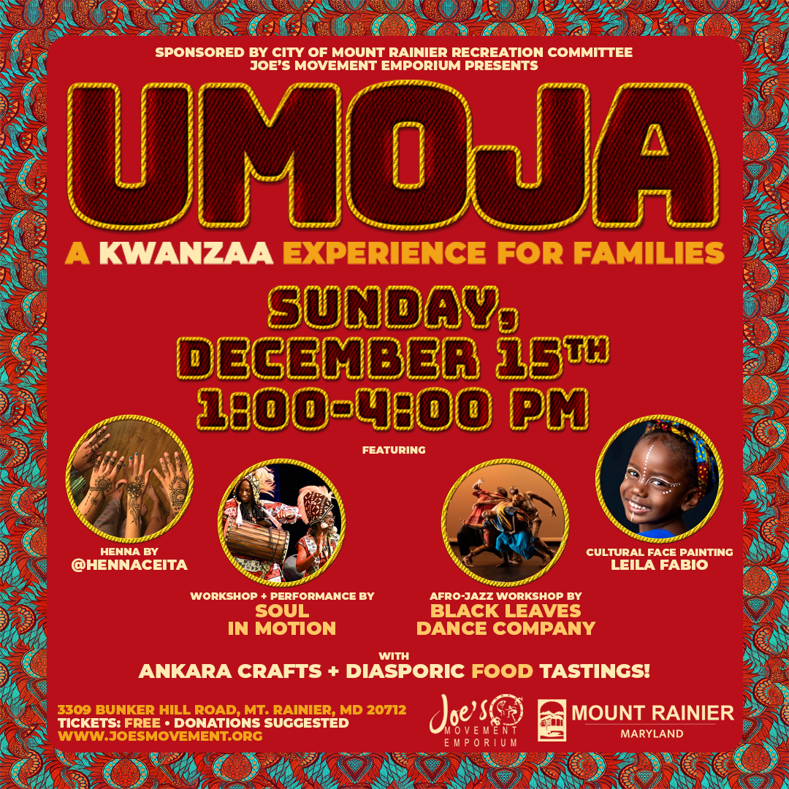
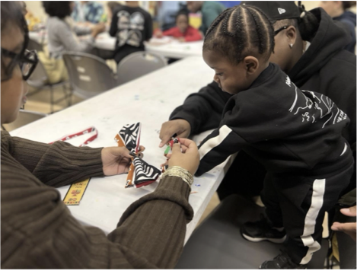
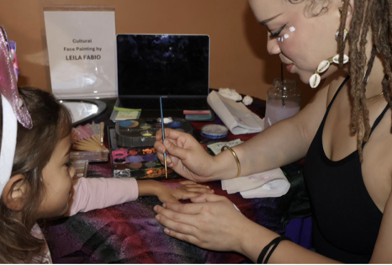
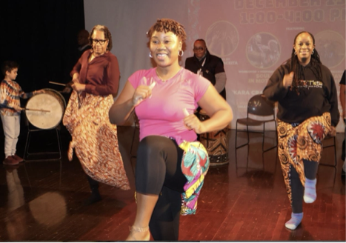
Recreation Committee FY25 Grantee
Joe’s Movement Emporium
December 15th, 2024 | Umoja: A Kwanzaa Experience for Families
Grant funds helped support Joe’s annual holiday crafting event celebrating Kwanzaa through the principle of Kuumba (creativity). Joe’s engaged visual and performing art instructors who live, work, or have studio space in MtR to lead event workshops. Umoja featured West African drum and dance company, Soul in Motion, cultural face painting, henna body art, and crafts.

Slide 10
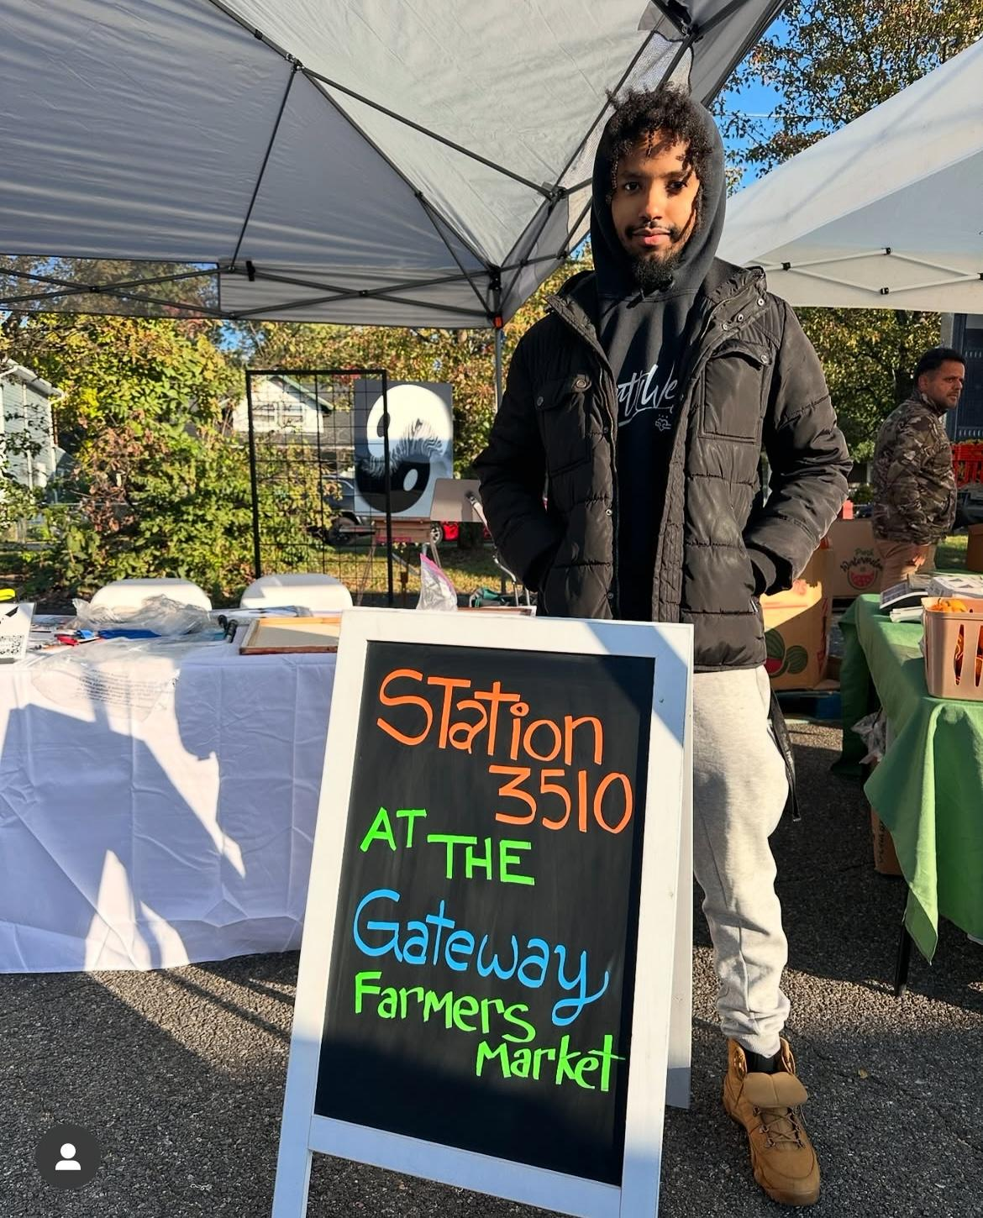
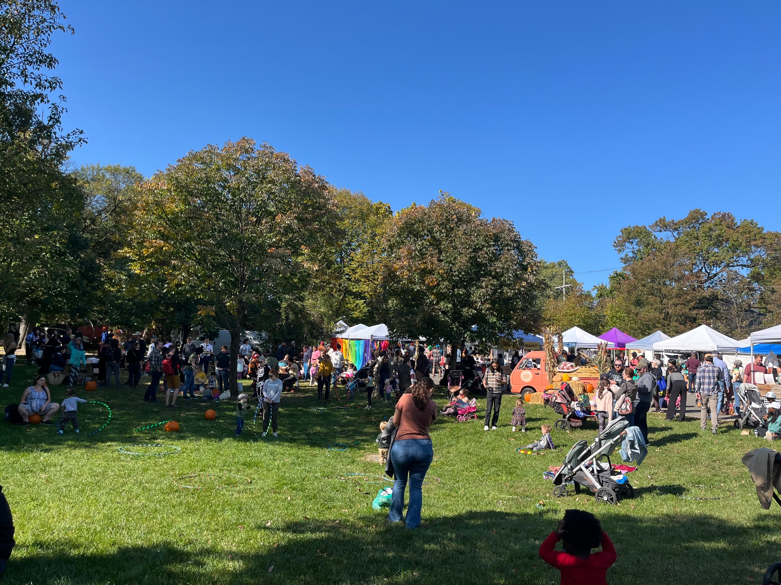
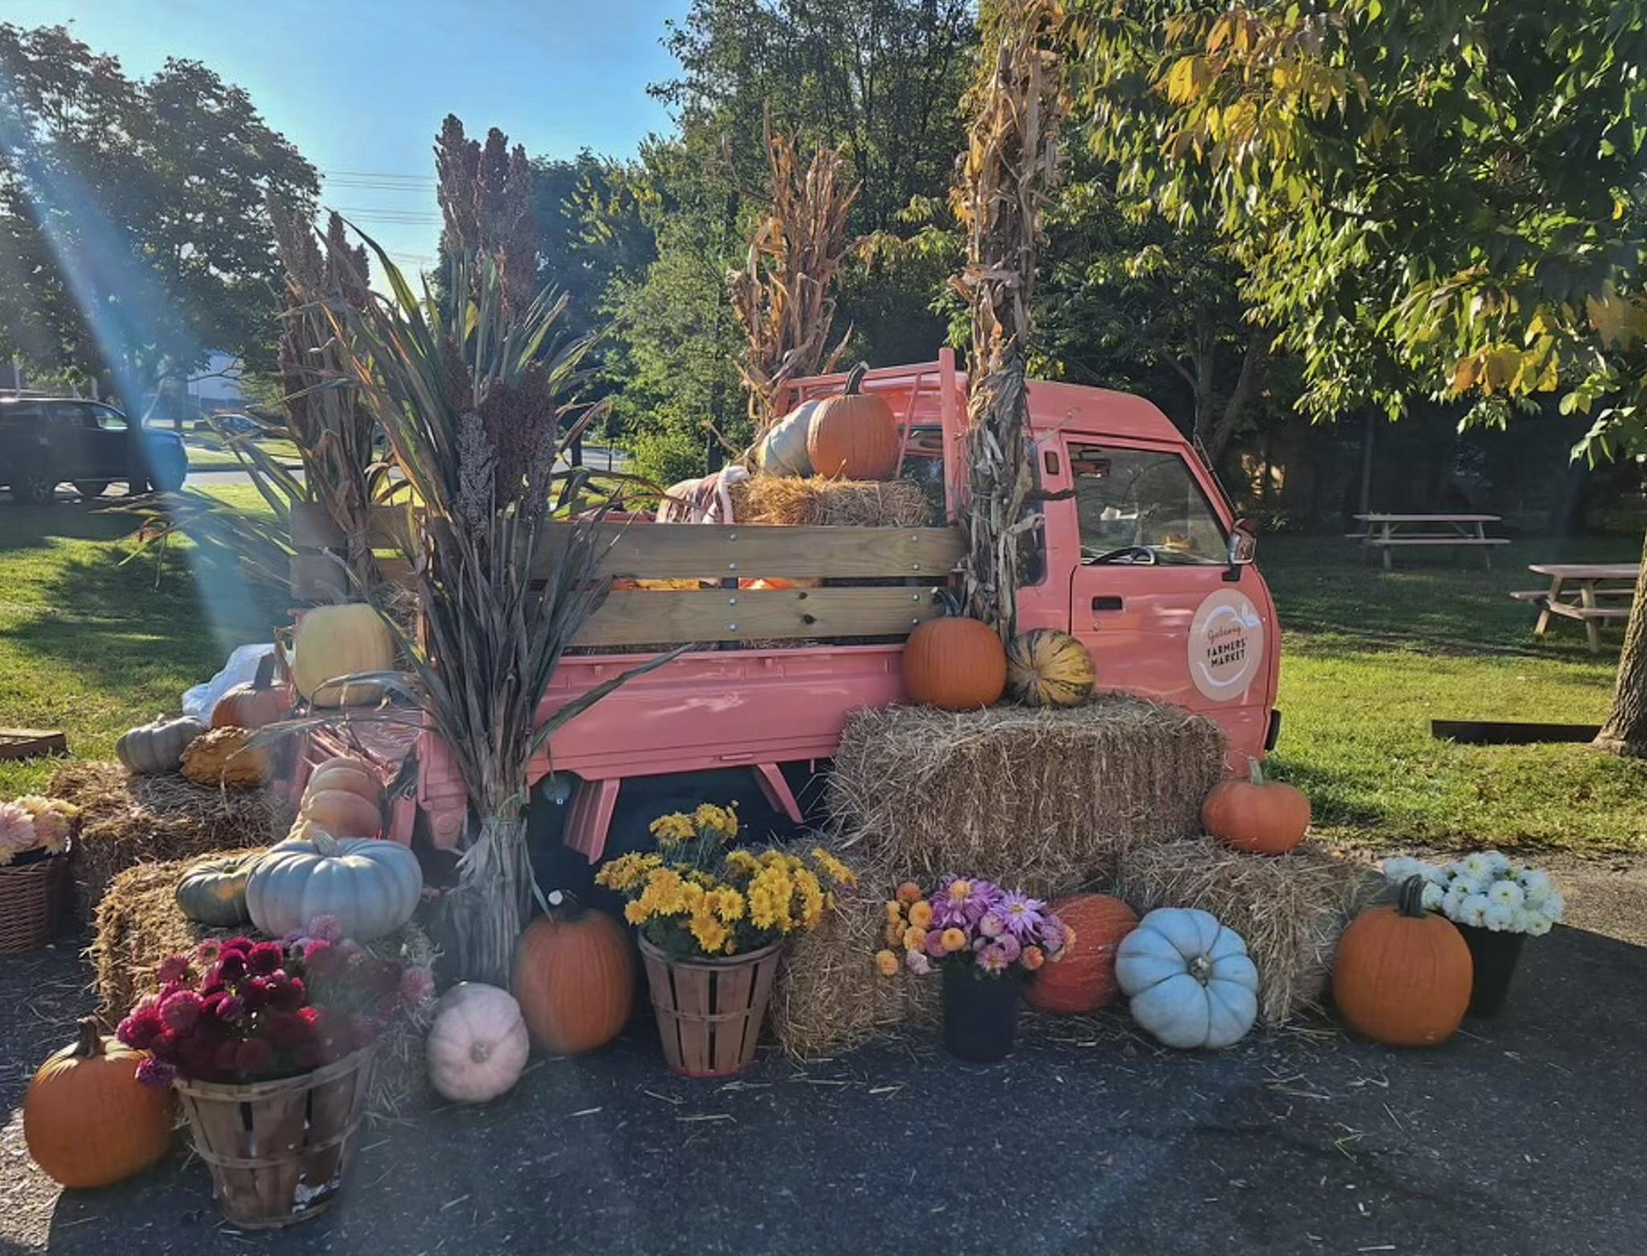
Recreation Committee FY25 Grantee
Gateway Farmers’ Market
“The event fostered community fun, appreciation for agricultural and environmental values, and brought people together. We thank the Mount Rainier Rec Committee for the support and hope to do it again!” - Megan & Gary
October 19, 2024 | Fall Fest
Grant funds helped provide locally sourced food and drink for attendees, as well as Gateway Arts Lab artists, free professional portrait photography on the fall decor scene of the market mini-truck, and free arts programming for kids delivered by Mount Rainier artist Becca Solow with The Creative Workshops DC. Regular market participants were joined by new local producers, including EcoCity Farm and even Mount Rainier’s own TV's bees.

Slide 11
2025 upcoming events
The Recreation Committee plans to host 4 impactful events every year, including:
COMMUNITY YARD SALE
April 5
PRIDE PARADE
June 2025
PORCHFEST
September 2025
3RD ANNUAL SWEATY SWEATER / FUN RUN
December 2025
Notes:
Earth Day– COORDINATED EVENT WITH SCHOOLS, GREEN TEAM AND PRINCE GEORGE’S COUNTY

Slide 12
Thank You!
RecreationCommittee@MountRainierMD.org
Stephanie Schlesinger, Co-chair
Emily Bird, Co-chair
Bethany Van Kampen-Saravia
Megan Haber
Jenny Hoffpauir

